Slide 1

What is the best method for turning visitors into members?

Slide 2

What is the current method to turning visitors into members?
When a visitor to MuscleHub is considering buying a membership, he or she follows the following steps:
Take a fitness test with a personal trainer
Fill out an application for the gym
Send in their payment for their first month’s membership

Slide 3
What could be wrong with the current method?
There are some concerns about the effectivity of the fitness test. What if some of the prospect members are intimidated by the fitness test?
To investigate this question we did :
a A/B test using the data of more than 5000 visitors
a series of interviews with visitors who became member and with those who did not become one

Slide 4
What does this A / B test entail?
In this test we use the data of 5004 visitors who visited MuscleHub between 7-1-2017 and 9-9-2017. Half of these visitors, group A, were asked to take the fitness test with a personal trainer. The other half, group B, skipped the fitness test and proceded directly to the application.
For every group we will count :
how many visitors filled in an application
how many applicants purchased a membership
how many visitors purchased a membership
If our hypothesis is correct then Group B will purchase a membership more often than Group A.

Slide 5
Testing the significance of the results.
After counting all the necessary data we performed the A/B test. In this situation the Chi Square Test was the best test to check the significance of the results. We chose this test because we had two categorical datasets to compare.
With this test it is important that:
the columns are each a different condition, Group A vs Group B
the rows represent different outcomes, like Applicant who became member vs Applicant who not became member
the result of the test is significant when the output is lower than 0.01

Slide 6
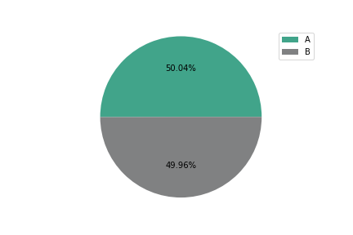
Group A and Group B were equal enough.
Before counting the applicants and the members we had to be sure of the fact that Group A and Group B were the same size. If there would be a big difference between those two groups the test would be worthless.
These results are displayed in the pie
chart at the right.
Group A contains 2504 visitors.
Group B contains 2500 visitors.
These numbers were equal enough
to move on with the test.

Slide 7
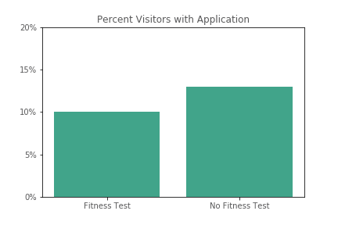
How many visitors pick up an application?
In Group A 250 visitors filled out an application. This is almost 10% of the visitors.
In Group B 325 visitors filled out an application. This is 13% of the visitors.
These results are displayed in the bar chart showed below.
This looks like a significant difference and that is true. When we run the Chi Square Test we get an output of 0.00096.
This is much lower than 0.01.
Conclusion: Visitors who skipped the fitness test
fill out an application more often.

Slide 8
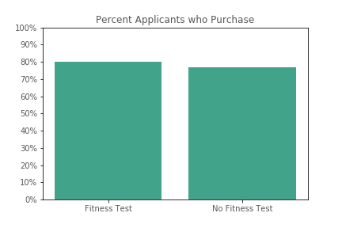
How many applicants purchased a membership?
In Group A 200 out of 250 applicants purchased a membership. This is 80% of the applicants.
In Group B 250 out of 325 applicants purchased a membership. This is 77% of the applicants.
These results are displayed in the bar chart showed below.
If we run the Chi Square Test we see a different
outcome. The output of the test is 0.4326 and
that means that this difference of 3% isn’t that
significant.
It looks like that applicants from Group A are
more motivated after applying than those of
Group B.

Slide 9
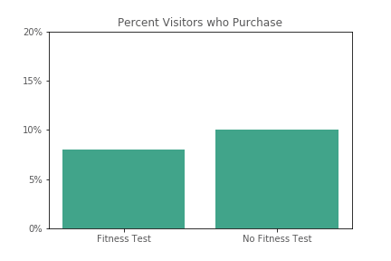
How many visitors purchased a membership?
In Group A 200 out of 2504 visitors (almost 8%) became a member of MuscleHub.
In Group B 250 out of 2500 visitors (10%) became a member of MuscleHub.
These results are displayed in the bar chart showed below.
When we run the last Chi Square Test we get an output of 0.01334. The difference is on the edge of being significant. 50 extra
members sounds like a lot, but on a number
of 2500 visitors it isn’t that impressive.

Slide 10
The interviews
“I always wanted to work out like all of the shredded people on the fitness accounts I see on Instagram, but I never really knew how to start. MuscleHub’s introductory fitness test was super helpful for me! After taking the fitness test, I had to sign up and keep coming back so that I could impress my trainer Rachel with how much I was improving!”
“I saw an ad for MuscleHub on BookFace and thought I'd check it out! The people there were suuuuuper friendly and the whole sign-up process took a matter of minutes. I tried to sign up for LiftCity last year, but the fitness test was way too intense. This is my first gym membership EVER, and MuscleHub made me feel welcome.”

Slide 11
The interviews
“When I walked into MuscleHub I wasn’t accosted by any personal trainers trying to sell me some mumbo jumbo, which I really appreciated. Down at LiftCity they had me doing burpees 30 seconds after I walked in the door and I was like “woah guys slow your roll, this is TOOOO much for Jesse!” I still ended up not signing up for a membership because the weight machines had all those sweat stains on them and you know, no thanks.”
“I took the MuscleHub fitness test because my coworker Laura recommended it. Regretted it.”

Slide 12
Most visitors don’t like the fitness test.
When we reed the interviews we see different kinds of visitors:
Visitors in Group A who liked the fitness test, because they want to achieve something
Visitors who were in Group A who didn’t like the fitness test
Visitors who were in Group B and didn’t had to do the fitness test and were happy about not having to do a test
What can we do to make all the different kinds of visitors happy and make them purchase a membership?

Slide 13
Should we quit the fitness test?
After seeing the results of the A/B test and reading the interviews we can conclude that having a fitness test with every visitor is not the best method to purchase as much memberships as possible. The A/B test showed us a difference of 2% between Group A and Group B.
If we quit the fitness test we gain 2% more memberships and we can save costs, because the personal trainers can work less hours. This sounds great!
But is this the best result we can achieve?

Slide 14
Don’t forget the people who liked the fitness test.
Most visitors would like to fill out an application without doing the fitness test. But still some of them do appreciate the test and think that the fitness test is helpful. You don’t want to miss some potential members by not offering the fitness test. Still 8% of the visitors who did the test purchased a membership.

Slide 15
The recommendation.
To decide which visitor we should offer a fitness test, we can make a short list with questions. With these questions we can separate the potential fitness test visitors from the other visitors.
What goal do you want to achieve?
Do you have experience with other gyms?
Maybe the most important question is :
Would you like some help discovering your potential?

